Slide 1

Analysis of “theLook eCommerce” dataset
Capstone project by Andrius Tunaitis
Notes:
Hello, I am Andrius Tunaitis and today I am going to present you the results of my capstone project, analysis of “theLook eCommerce” dataset.

Slide 2

What has been analyzed?
Dashboard
Sales, profit, profit margin
RFM
Purchase funnel
Notes:
Analysis of TheLook eCommerce dataset started with a development of a dashboard. This dashboard was created to allow the user to explore the available data.
By looking into the dashboard and carrying out further analysis, sales, profit and profit margin results were discussed.
Furthermore, RFM segmentation was done and suggestions for actions were recommended.
Lastly, purchase funnel was analyzed for all users as well as different browsers and traffic sources.

Slide 3
How are the sales looking?
Notes:
Let’s start by looking how are the sales looking?
In the presented graph we can see monthly sales numbers for 2022 compared with the results from 2021.
First thing that comes to mind is the continuous growth of sales.
Since July 2022 every month’s results beat the previous month’s.
When comparing with monthly numbers of 2021 every month’s result has grown approximately twice.
It should be noted that the sales growth has increased in 2022 when compared with 2021.
In 2021 monthly sales have grown from 110k $ to 188k $ which is a 71 % growth.
As in 2022 monthly sales have grown from 203k $ to 427k $ which is a 110 % growth.

Slide 4
And what about profit?
Notes:
When we look at the profit graph we see a similar story to the sales.
Monthly profit in 2022 compared to 2021 has roughly doubled.
Monthly profit in 2021 grew by 71 % from 57k $ to 98k $.
As in 2022 it grew by 101 % from 106k $ to 222k $.
Yearly profit in 2021 was 888k $ and grew to 1.8M $ in 2022.

Slide 5
Profit margin
Notes:
A different story is seen when looking at the profit margin.
There were four months (April, July, September and November) when profit margin was smaller in 2022 compared to 2021.
Overall, in 2022 we saw a small increase in profit margin as it grew by 0.2 % to 51.9 %.
Even though the profit margin is not growing it still looks pretty healthy well above the average in ecommerce (41.54%)

Slide 6

How to improve profit margin?
Reduce operating costs
Increase AOV (cross-selling, upselling, bundle deals).
Create customer loyalty program.
Raise prices.
Notes:
Despite the fact, that our profit margin is above ecommerce average we should be aware of the ways how to improve it.
A good way to do that is to reduce operating costs.
In order to not make any harsh decisions it would be smart to review these areas: labor costs, office space, utilities, equipment and maintenance fees, employee benefits, licenses.
Another way is to increase the average order value.
It can be done by suggesting bundles, using cross-selling or upselling techniques.
Creating a customer loyalty program could also improve profit margin, as it would help retain existing customers and avoid having high customer acquisition costs.
Last suggested option is to consider raising prices.

Slide 7
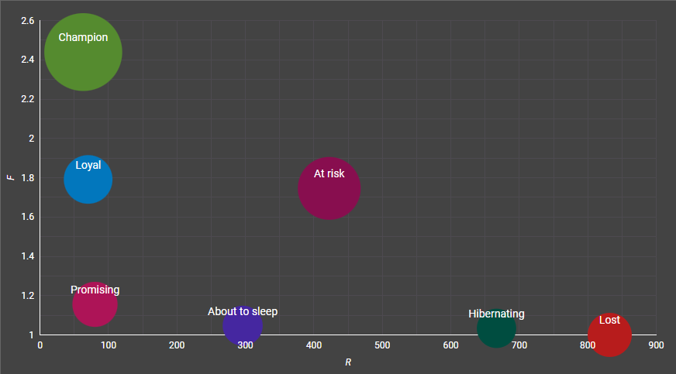
What kind of user segments do we have?
Notes:
Next, we carried out the RFM analysis. Customers were divided into segments based on the recency, frequency and monetary values of their orders.
We assigned users into 7 different segments. Champion, Loyal, Promising, At risk, About to sleep, Hibernating and Lost.
Let’s quickly go through them:
Champion – bought recently, often and spent most.
Loyal – similar to champions, but the monetary value is a bit smaller.
Promising – recent shoppers that haven’t bought very often.
About to sleep – below average RFM values, we will lose them if not reactivated.
At risk – spent a big amount and often, but haven’t bought recently.
Hibernating – bought a long time ago, below average frequency and monetary values.
Lost – lowest RFM scores.

Slide 8
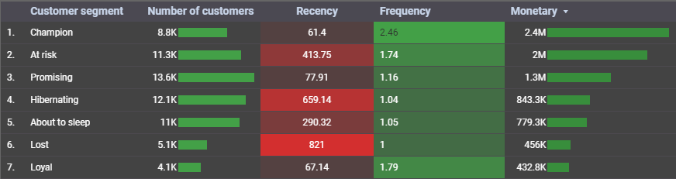
What are the RFM values?
Notes:
Here we can see that the “champion” segment has the biggest monetary value (2.4M $), which makes sense.
However, second biggest segment by monetary value is “At risk”. We should pay great attention to this segment.
Also, we need to improve the “Loyal” segment as it is the smallest by both number of customers and monetary value.
While the pareto principle does not fully apply here, Top 3 categories by total monetary value make up roughly 70 percent of the whole sum.
So it would make sense to give more attention to these 3 categories while also not forgetting about the others.

Slide 9
Actions for different segments
Segment | Tip
Champion | Introduce new products for them, include to a rewards system.
Loyal | Upsell, cross-sell, include to a rewards system.
Promising | Introduce to a rewards system.
At risk | Recommend on previous purchases, offer discounts, limited time offers.
About to sleep | Recommend popular products, offer discounts.
Hibernating | Offer discounts.
Lost | Send e-mails to reach out.
Notes:
Now let’s look into the suggestions for different actions for RFM segments.
For the “champion” segment we suggest to introduce new products for them and include them to a rewards system.
In this way these users will feel rewarded as well as they will become early adopters for new products and promote our brand.
Suggestions for the “Loyal” are to upsell, cross-sell as well as including to a rewards system.
Cross-selling and upselling would increase the monetary value for this segment while the rewards system would help to retain these users.
Going forward, we want to retain the users in the “Promising” segment, we suggest to introduce them to a rewards system.
The “At risk” segment as stated before is very important because of the monetary value.
We suggest to recommend products on previous purchases, offer discounts and limited time offers.
In order to reactivate the “About to sleep” segment it is suggested to recommend popular products and offer discounts.
Similar suggestions are valid for the “Hibernating” segment.
Lastly, for the “Lost” segment we recommend to sent reach out e-mails and ignore otherwise.

Slide 10
Is our purchase funnel getting better?
Notes:
Lastly, we carried out the funnel analysis.
As there were not many different event types in the dataset it was decided to use “product”, “cart” and “purchase” events.
Here we can see two funnels: For the first operating year which is 2019 and for the last full year, 2022.
We can notice that there has been a significant improvement for the funnel, as “cart” has grown from 52% to 71%, while “purchase” has grown from only 4 % to a ten-fold increase to 42 %.
To conclude, we can say that the purchase funnel is getting better.

Slide 11
Funnels by different browsers
Funnel step | Chrome | Safari | Firefox | IE | Other
Product | 100 % | 100 % | 100 % | 100 % | 100 %
Cart | 79,6 % | 79,39 % | 79,86 % | 80,92 % | 79,45 %
Purchase | 57,62 % | 57,89 % | 58,27 % | 58,13 % | 57,16 %
Notes:
Now let’s look into the purchase funnel for different browsers.
The biggest percentage of users continue to the “cart” when using Internet explorer (80,92 %) while values for other four categories do not differ much (from 79,39 % to 79,86 %).
The highest value for “purchase” is 58,27 % for Firefox, however other four categories do not fall behind by much as “Other” has the lowest percentage at 57,16 %.

Slide 12
Funnels by different sources
Funnel step | Email | Adwords | Youtube | Facebook | Organic
Product | 100 % | 100 % | 100 % | 100 % | 100 %
Cart | 79,9 % | 79,35 % | 79,47 % | 79,66 % | 79,83 %
Purchase | 58,25 % | 57,18 % | 57,27 % | 57,66 % | 58,89 %
Notes:
How does the funnel look for different traffic sources.
The highest value for “Cart” is for the email traffic source at 79,9 % while the worst is not that far behind at 79,35 % for Adwords traffic source.
When it comes to “Purchase” step we see the highest value for organic users at 58,89 % while the worst is less than two percent lower at 57,18 % for Adwords.
All in all, the purchase funnel seems to be improving through the years.
However it is difficult to find different browsers or traffic sources that greatly outperform the others.

Slide 13
Conclusions and suggestions:
Maintain growth of sales and profit.
Increase profit margin.
Take care of main customer segments.
Keep an eye on purchase funnel dynamic.
Notes:
To conclude, after all the results analyzed we suggest:
We need to maintain the steady growth of sales and profit. We can do that by always adding more categories to our product collection.
While our profit margin is above the industry average we should try to improve it. We can do it by reducing operating costs, increasing prices, cross-selling and upselling.
We need to take care of main customer segments. We need to retain the “champions” and reactivate the “at risk” segment.
Lastly, while the purchase funnel is improving we need to continually review it and respond to any negative changes.

Slide 14
Thank you! Any questions?
Notes:
Thank you for your attention.
Do you have any questions?

